Slide 1
The State of Cinema
An Analysis of Films Ratings Over Time
By Melanie Boychuk, Mitch Rimerman, Matt Gnanadass, and Kaitlyn Wood

Slide 2
mOTIVATION
About a year ago, filmmaker Martin Scorsese wrote an opinion piece in the New York Times (https://www.nytimes.com/2019/11/04/opinion/martin-scorsese-marvel.html) defending his claim that Marvel Movies were not cinema. He defined cinema as an art that overwhelms and explores the unknown. He then argued that the almost formulaic Marvel Movies coupled with the rise of streaming make it impossible to overwhelm, to be cinema. Based on his claims, we wanted to explore the trends of the film industry and better understand what it is producing along with who engages with it and how.

Slide 3
Questions
How have all genres been received by audiences over time?
01.
How has drama as a genre fared against actions films in terms of audience enjoyment?
02.
What role do age and gender play in film consumption?
03.

Slide 4
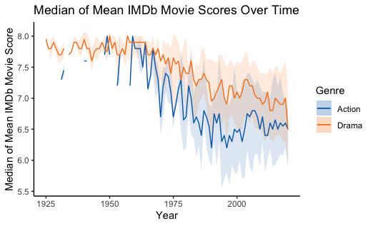

Drama Vs. Action
Despite both genres having a overall downward trend in average ratings, dramas have historically received
on average higher votes on IMDb than action
films, especially after 1950. However,
there has been a slight upwards
tick in action ratings
since 2000.

Slide 5
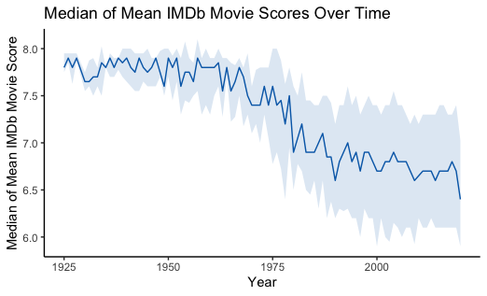
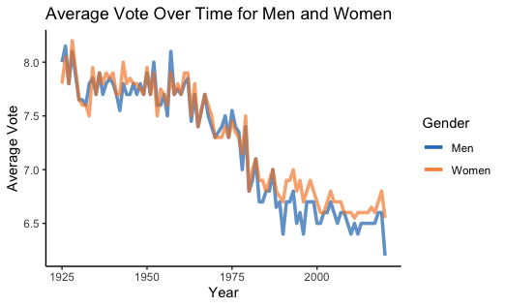
Total votes over time
Saturn
Venus
Mars
It’s composed of hydrogen and helium
Despite being red, Mars is a cold place
Median score of about 7.7 for movies released in 1925, dropping to a median of about 6.5 for movies released in 2019.
Men give marginally lower ratings than women for movies released in the 1980’s to 2010’s.
General downward trend of median movie ratings.

Slide 6
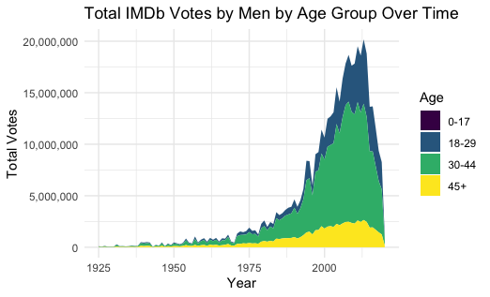
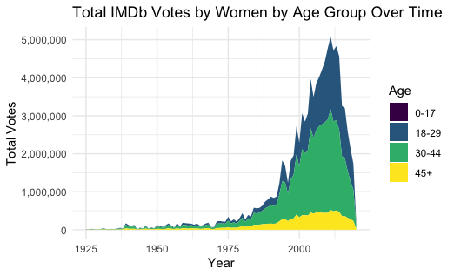
Total Votes by Gender and Age
Men
Women
Men, like women, start with relatively low total votes then a spike starting in around 1975 and peaking in around 2010. In general, the 30-44 age group dominates. However, the 18-29 age group seems to be increasing quite quickly proportionally in the more recent years.
The women follow the same total trend as the men. However, we see a larger proportion of women voting in the more recent years are in the 18-29 year-old age range than men.

Slide 7
Total Votes by Gender
Men
Women
The total number of men’s votes in a year peaks around 2010 at about 20,000,000 votes
Meanwhile, women’s peak around the same time at only around 5,000,000

Slide 8
COnclusions
Ratings have become harsher over time across all genres and demographics. Moviegoers may have become desensitized to the moviegoing experience, being exposed to so many films that they are more particular about high-score criteria. This is supplemented by our visualization displaying total votes, in which not many ratings are given to old movies (likely due to a lack of them) and many more are given to newer movies.
Drama is rated higher across time than the action genre, and has generally more consensus than action movies, which have large discrepancies and variation in scores. This may be due audience opinion similar to that of Martin Scorsese’s - that action is not true cinema, while drama is a prototypical example of cinema.
We see the same trends for movie ratings across gender, but see men and older demographics giving more ratings than women and younger viewers. This could potentially improve the ratings of older films, as older generations are more likely to watch dated movies and to hold a negative bias towards newer movies. However, the 0-17 age group, for which there is admittedly little to no rating information, rates movies similarly to older generations. If more of their rating data was collected, this might reverse the trend shown in older generations.

